Slide 1
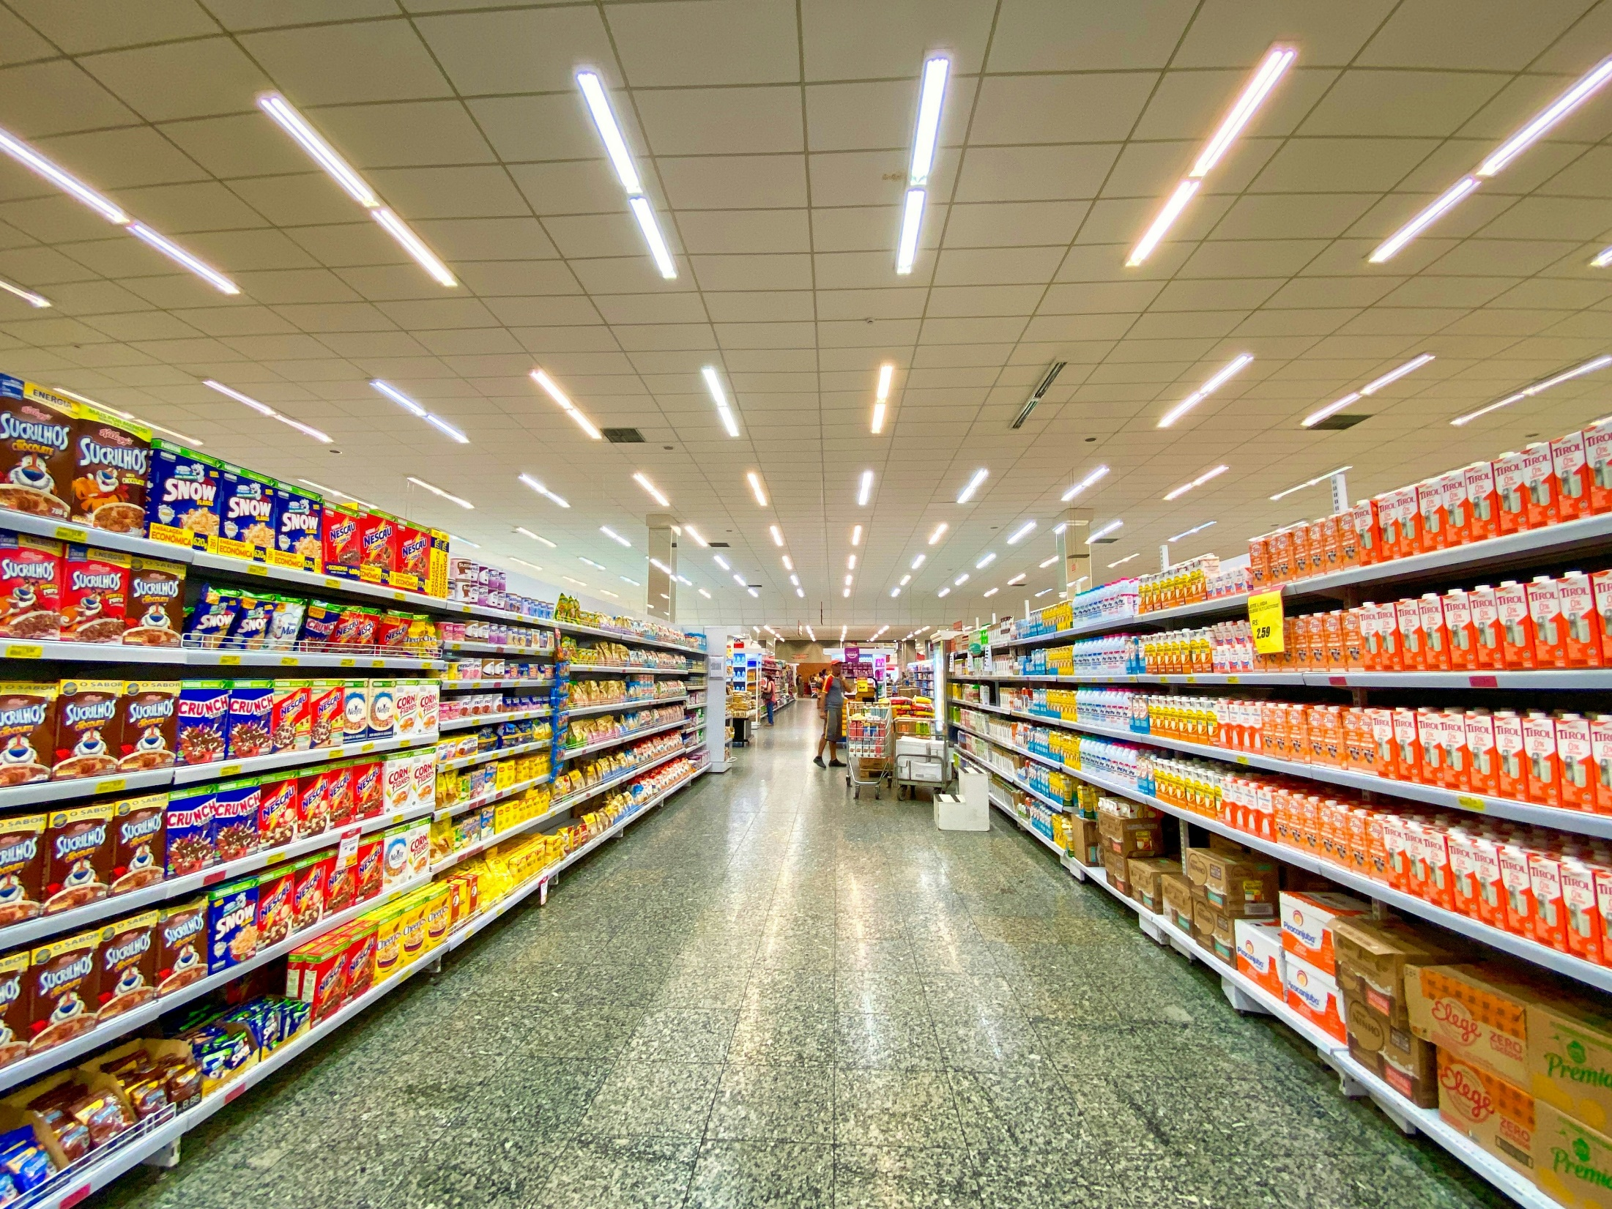
RETAIL STORE ANALYTICS
RETAIL STORE ANALYTICS

Slide 2
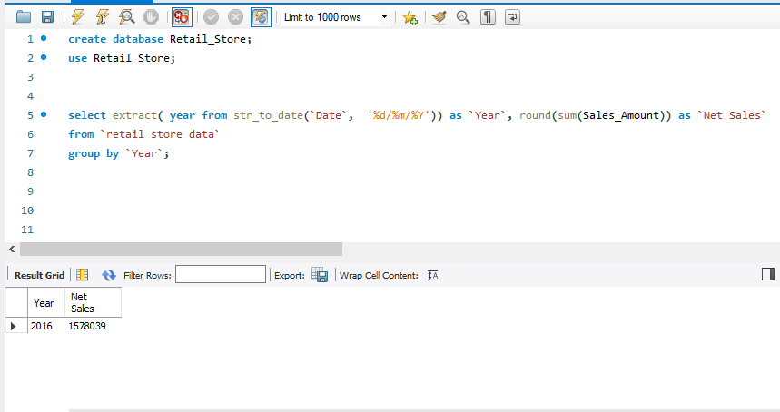
Total Annual Sales
The total annual sales of the grocery store in the year 2016 amounted to ₹15,78,039.

Slide 3
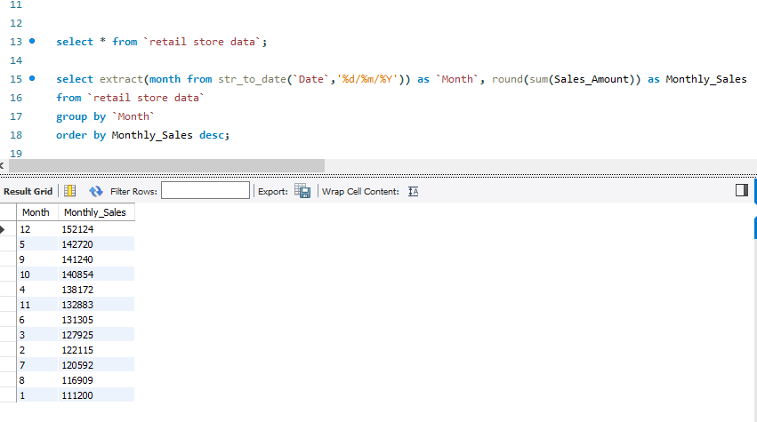
Monthly Sales
December has the highest selling record where as January is the Lowest.

Slide 4
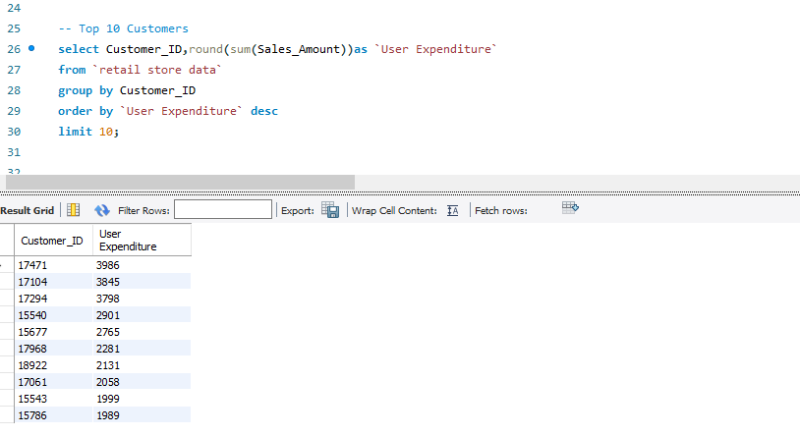
Top 10 Customers

Slide 5
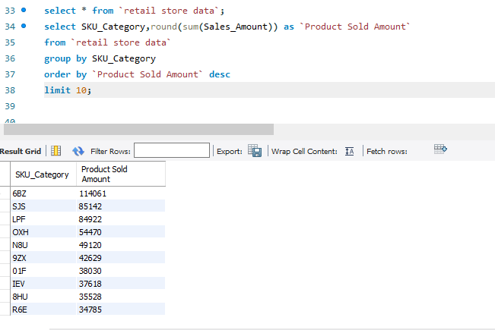
Top 10 Products Sold

Slide 6
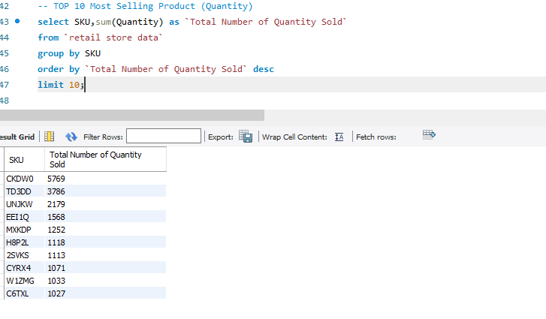
Top 10 Products (Quantity)

Slide 7
Conclusion
It is seen that The Store might not perform well in January but in performed well in the last quarter of the year.
Top Customers must be rewarded especially with purchasing of more than 3000.
Most selling product in the context of Quantity must be in stock usually.

